Slide 1
Emulators for Cosmological Parameter Space
Works by: Yijie Zhu, Evan Saraivanov
Supervised by: Vivian Miranda
Presented by: Yijie Zhu
Yang Institute of Theoretical Physics, Stony Brook University
Oct, 2024

Slide 2
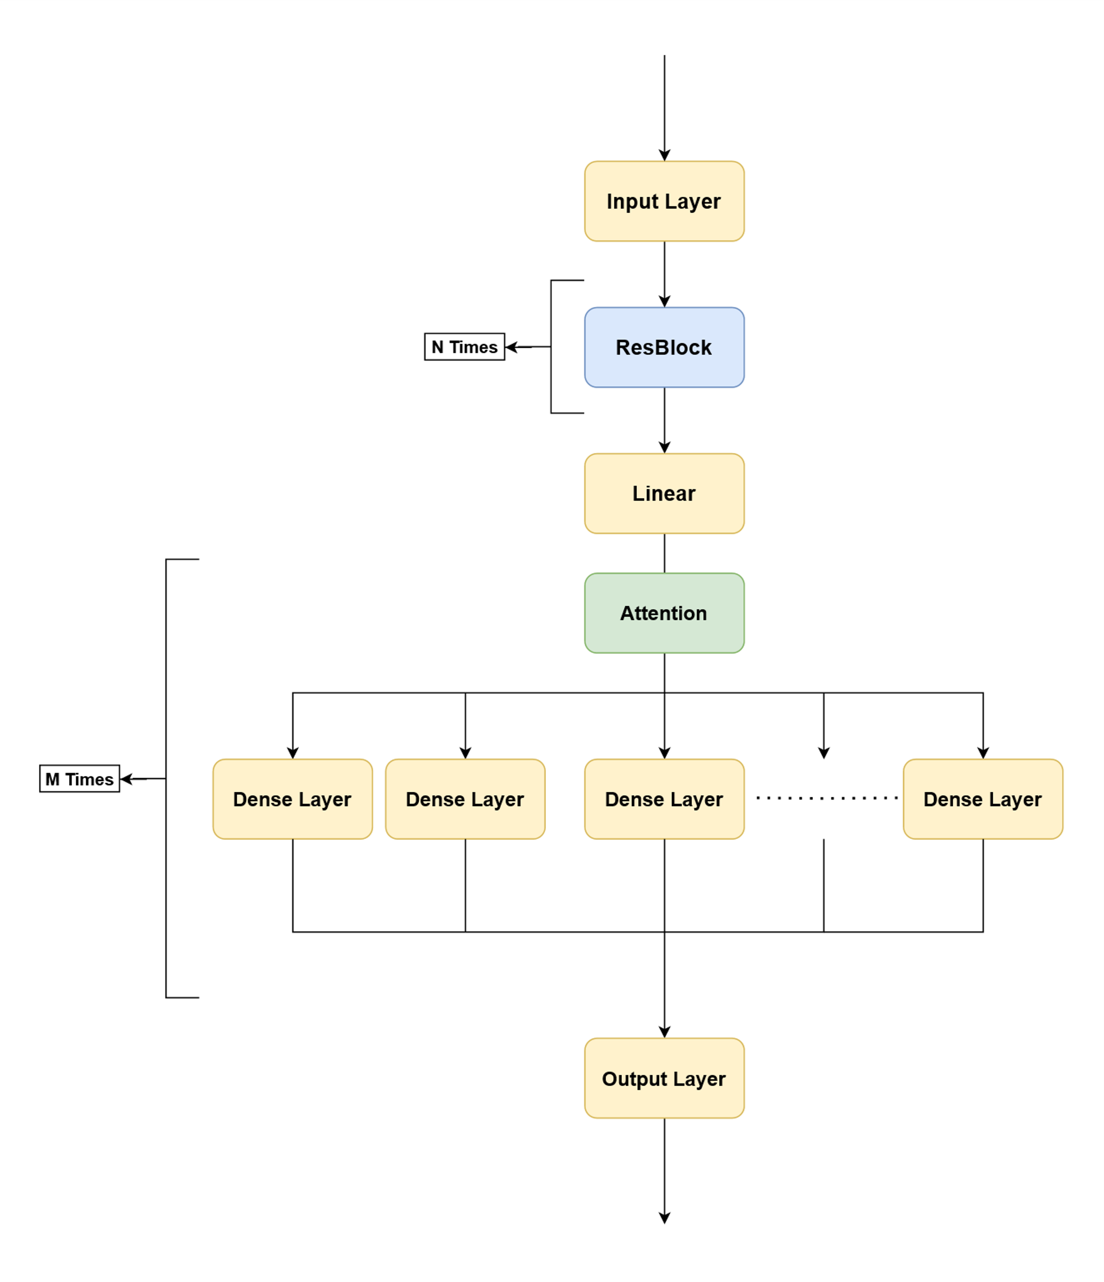
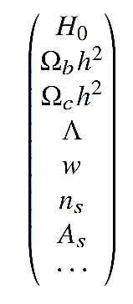
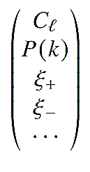
Emulator for Cosmology

Slide 3
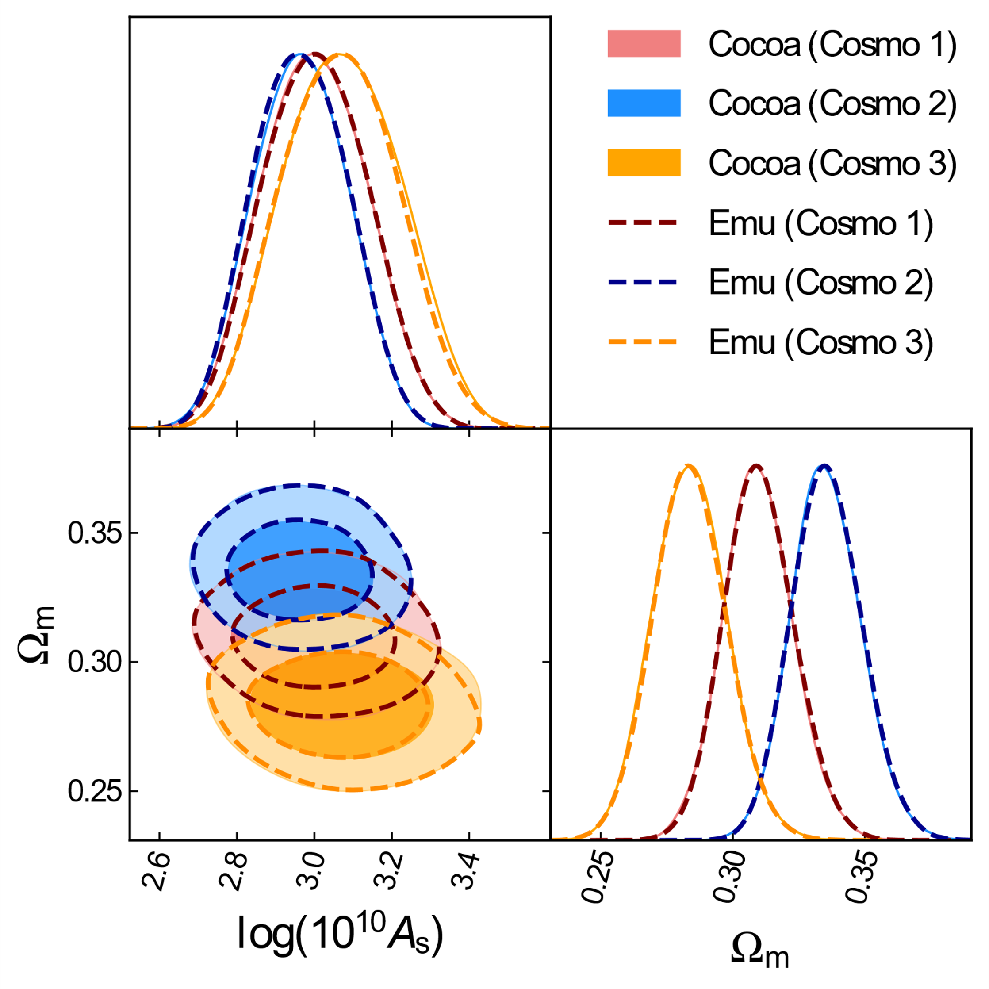
Results on Cosmic Shear
High precision in large parameter space
Emulator validity does not change if we shift the fiducial point in chain

Slide 4
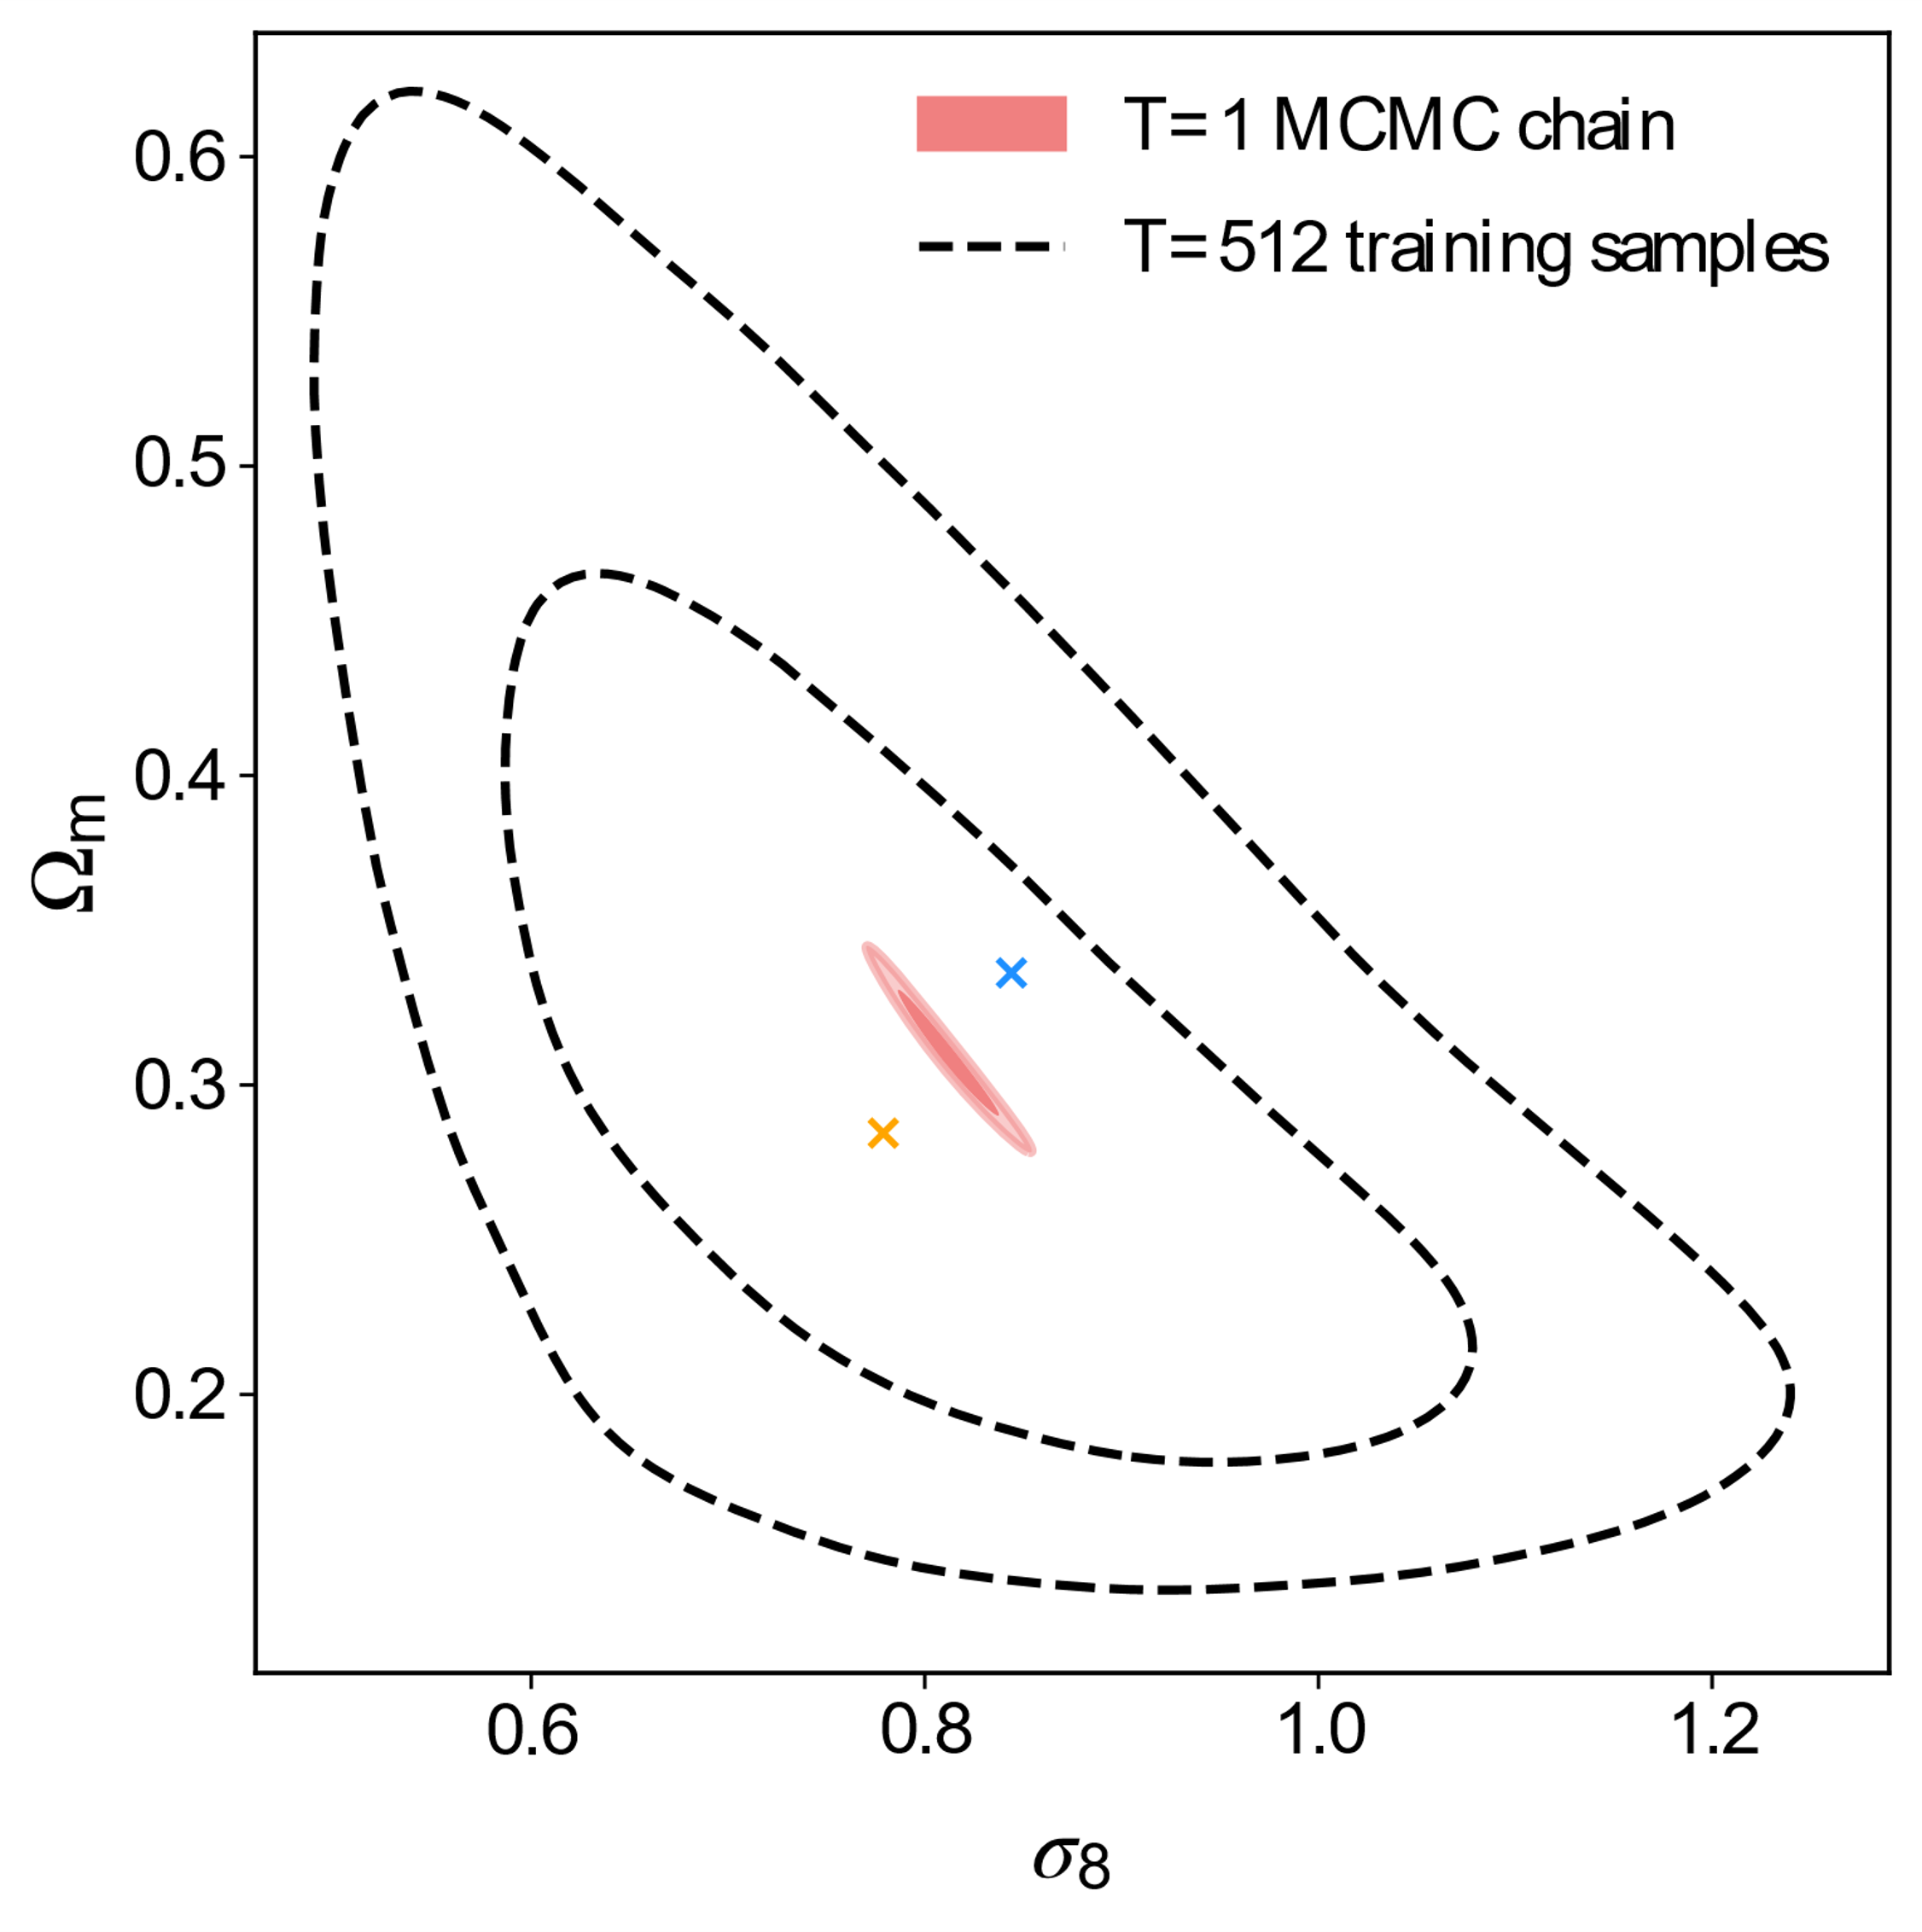
Goal of the Part III
We want to develop emulators for huge parameter volumes for 3x2pt and CMB power spectra
The fraction of points with chi^2>0.2 needs to be below 10%
Use as few data vectors as possible: development in loss functions and activation functions
Extend to models with more parameters

Slide 5
Results for 3x2pt

Slide 6
Sampling for CMB

Slide 7
Results for CMB

